Slide 1
Q355/Q590 Today: Neurophysiology

Slide 2
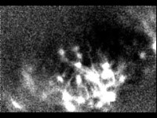
Stuber lab, UNC - https://www.youtube.com/watch?v=j7aOwjGLOq0
Notes:
Neurons recorded from hippocampus of a freely moving mouse.

Slide 3
What is happening in that video?
Neurons are firing
Neurons are communicating with each other
But, how?
Notes:
Neurons are firing → What does firing mean? → How is it happening? → What are the neurophysiological events involved?
Neurons are communicating with each other? → How does that happen?

Slide 4
Overview of Lecture
Neurophysiology of neurons – action potentials
Hodgkin-Huxley model of action potential generation
Neurophysiology – transmitter release
Neurophysiology – learning
Notes:
Neuroanatomy = “Nervous system STRUCTURE”
Neurophysiology = “Nervous system FUNCTION”

Slide 5
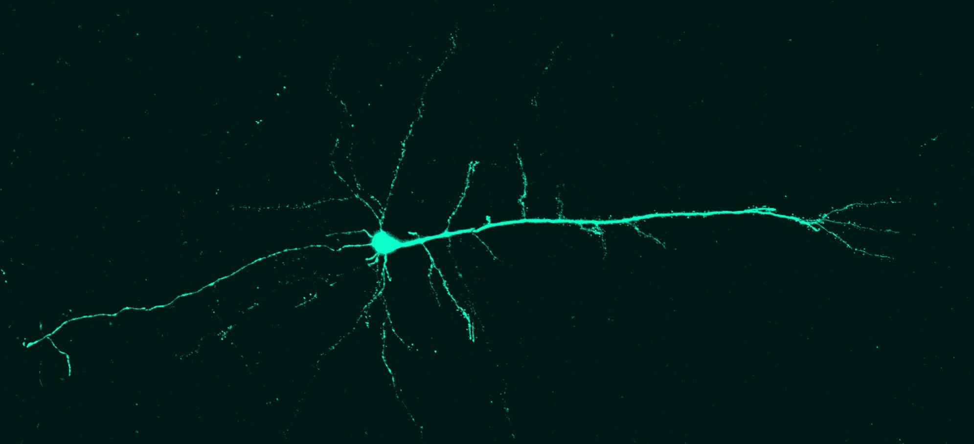
What does a single neuron look like?
Axon
Axon terminals
Axon hillock
Cell body
Dendrites
Stuber lab, UNC - http://www.stuberlab.org/gallery
Notes:
Cortical neuron Rabies tracing – A modified rabies virus is used to specifically infect certain types of neurons (the virus envelop can only bind to certain types of receptors and thus only infects the neurons with that receptor). The protein expressed by the virus is labelled and thus, it helps visualizing the whole neuron.

Slide 6
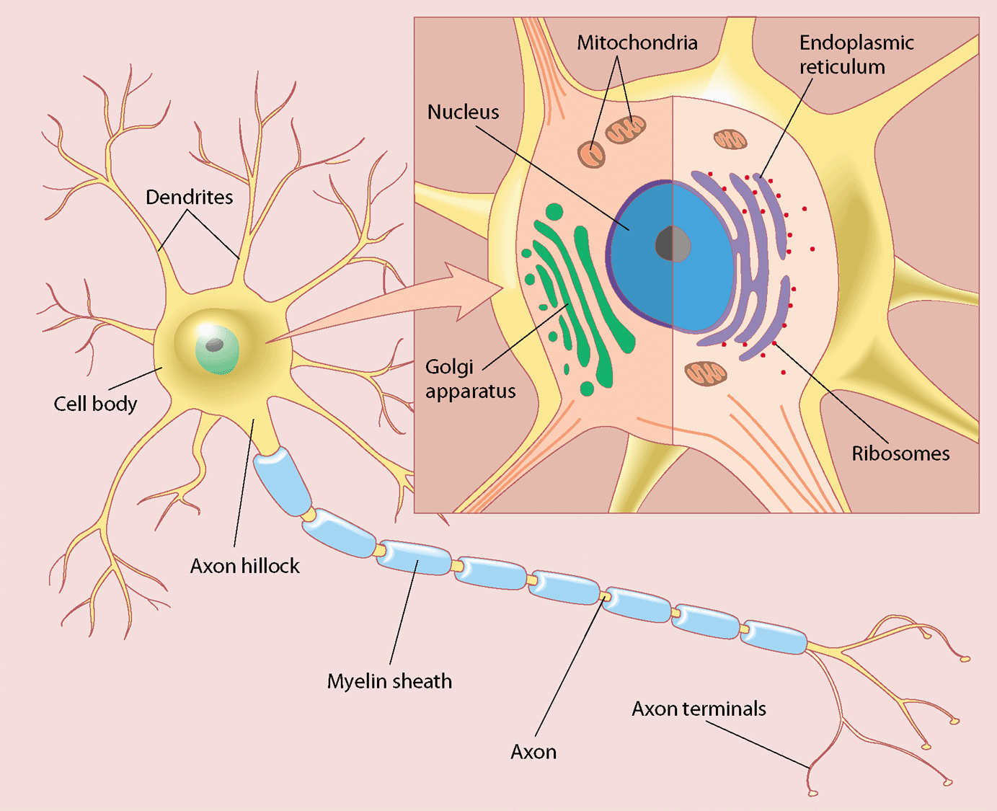
Notes:
More illustrative picture of the neuron. This neuron his has multiple neurites coming out of its body and thus, it is called multipolar neuron. This is the most common type, plain vanilla type of neuron, but there is other variety too!

Slide 7
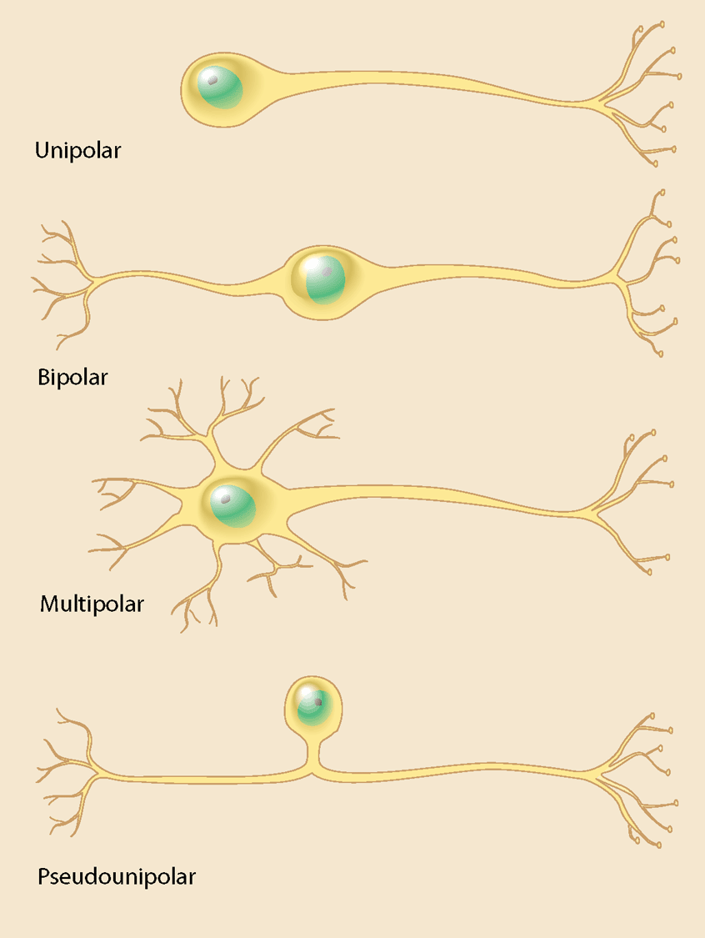
Adapted from Kandel, E.R. Schwartz, J.H., and Jessell, T.M. (Eds.), Principles of Neural Science, 3rd edition. Norwalk, Connecticut: Appleton & Lange, 1991. Copyright © 1991 by Appleton & Lange.
Notes:
Dendrite collects the input for the neuron while axon is the output of the neuron. However, it is important that it is not written in stone. There are some neurons in which the input comes directly through the cell body or even the axon. But those neurons are rare.
The neuron that we were looking at earlier was multipolar. The unipolar neurons are generally found in invertebrates like insects. The other neurons are found in our body.

Slide 8
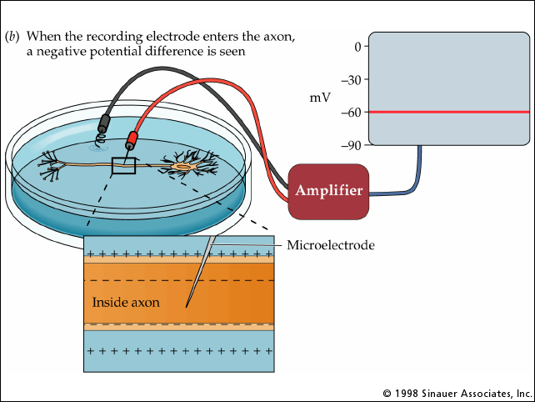
How do neurons talk? How is action potential generated?
But first, neuronal membrane potential -
The potential of inside of the resting neuron wrt the outside is negative.
Notes:
Understanding of how resting membrane potential is maintained is critical to understanding how action potential is generated. Resting neuron – Potential of inside is negative wrt outside.

Slide 9
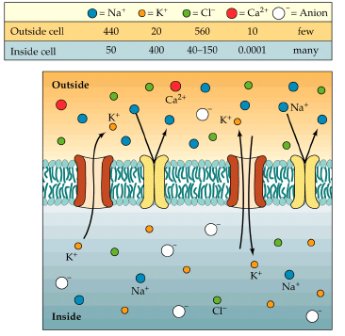
Ionic gradients across the membrane lead to neuronal resting membrane potential
Na+: IN < OUT
More salty outside!
Cl-: IN < OUT
Ca2+: IN < OUT
K+: IN > OUT
A-: IN > OUT
Notes:
Nacl – common salt; isn’t it interesting that first life forms developed in sea water, which is abundant in Nacl → maybe just maybe that’s the reason why our cells developed mechanisms to make use of it!
More positive charges outside as compared to inside. But, since the membrane is permeable to ions, how is this charge separation maintained?

Slide 10








A
B
A
B
After a while
$μ :A>B$,
$$V :A=B$$
$μ :A=B$,
$$V :A=B$$
$$Electrochemical gradient:△μ+△V= Nonzero$$
$$Electrochemical gradient:△μ+△V=0$$
A
B
A
B
+
+
+
+
+
+
+
After a while
+
+
+
+
+
+
+
+
+
$μ :A>B$,
$$V :A>B$$
$μ :A=B$,
$$V :A=B$$
$$Electrochemical gradient:△μ+△V= Nonzero$$
$Electrochemical gradient:△μ+△V=$0 + 0 = 0
Notes:
Consider this system with A and B compartments; There is a chemical species → more conc in A, less in B, a wall separates these 2 compartments → permeable to the chemical species → what will happen after a while ? → (Example of ink in water, coffee drop on clothes) → diffusion→that chemical potential difference between these 2 places that are connected → it is just like how the electricity flows between the 2 points at different electrical potentials connected by a conductor.
Now, say, I wanted to keep the concentration as it is in this system. How can I do that? No simple solution for this, however, if this chemical species was charged, we could do something - could apply electric field in direction opposite to that of chemical potential, chem. A>B, elec can be applied B>A

Slide 11

E_{o}
The ion gradient between A and B will stay as it is if,
the electrochemical gradient between A and B can somehow be made = 0
+
+
+
+
+
+
In other words, the net electrical potential difference balances the net chemical potential difference between A and B; in several other words, the electrical force on ions cancels out the ‘diffusion force’.
+
+
A
B
Net $△V$= $△μ$
This happens when, $E= \frac{RT}{zF}$ln $\frac{Ca}{Cb}$
(here, E is electric potential of compartment B wrt A; Ca is concentration of ions in A, and Cb is concentration of ions in B)
→ Nernst Equation
Notes:
I can apply this external electric potential between these compartments such that delta V which is electric potential difference between A and B is equal and opposite to delta mu which is chemical potential difference between the two. ……………So, The ion gradient between A and B will stay as it is if, delta V = - delta mu → this means delta V + delta mu is zero → which is the electrochemical potential between the two.

Slide 12
Notes:
Start applying external electric potential from 0 and slowly increase it until X stops flowing. Let’s see what is happening at a certain value of electric potential V.
(Gibbs free energy release → comes from second law of thermodynamics → entropy is increasing and thus gibbs free energy released).

Slide 13
Notes:
Another approach of getting at the Nernst equation → you can also derive it by balancing the ion fluxes.
LHS → Fick’s law
RHS → dV/dX is basically the electric field
Mu: Electrical mobility (cm2/volt*sec)
D: Diffusion constant
(D = mu*Kb*T/q) → Einstein’s relation
----------
This approach is better because there is likelihood of erring when doing this for multiple neurons.

Slide 14
E is called the Nernst potential of ion C → Potential required to maintain the ionic gradient at concentrations (Ca, Cb)
+
+
+
+
+
+
+
+
Nernst potentials for Na, and K ions across the membrane:
E_{Na} ~ +60 mV
E_{K} ~ -75 mV
Note: When we talk about neuronal membrane potentials, the convention is to refer to the potential inside wrt the outside of the cell.
A
B
Notes:
Nernst equation gives us a value of potential difference that we need to apply in order to maintain the ionic gradient of a certain ion.

Slide 15




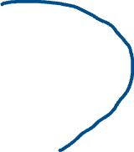
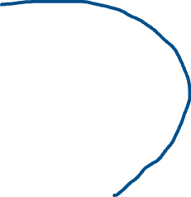

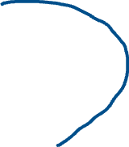



Slide 16
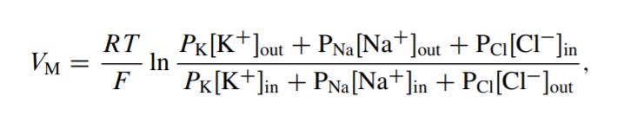
Goldman-Hodgkin-Katz equation
In case of multiple ions (which is the case around neuronal membrane), the required voltage that needs to be maintained to keep them at their ionic gradients is given by Goldman-Hodgkin-Katz equation –
= roughly, -70 mV
Here, [X]_{out} - concentration of ion X outside the cell
[X]_{in} - concentration of the ion X inside the cell
P_{x} – Permeability of the ion X through the membrane
R – Ideal gas constant
T – Temperature
F – Faraday’s constant
Note: This equation is for mono-valent ions. For divalent ions, a ‘2’ would appear in denominator; For a mix of mono and divalent ions → write the flux balance equation shown a couple slides back for multiple ions taken together, assume V to be constant across the length of the membrane→ this will give a quadratic equation in x where, x = e-FV/RT, solve for x.

Slide 17
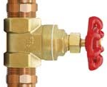
Water tank analogy
High water level – high sodium voltage
Sodium valve open → Water level rises (by analogy, membrane voltage rises)
Water level – Membrane voltage
Valve -- Sodium conductance
Valve – Potassium conductance
Low water level – low potassium voltage
Potassium valve open → Water level falls (by analogy, membrane voltage falls)

Slide 18
How is the required V_{M} maintained across neuron membrane?
Organic anions, A-, to which the membrane is impermeable
Electrogenic pumps that actively transfer ions against their ionic gradients
Notes:
So, GHK equation gives us the electric potential that we need to apply across the neuronal membrane to maintain the ionic gradients. Who applies this electric potential or how does this electric potential gets applied?
Passive redistribution
Active transport

Slide 19
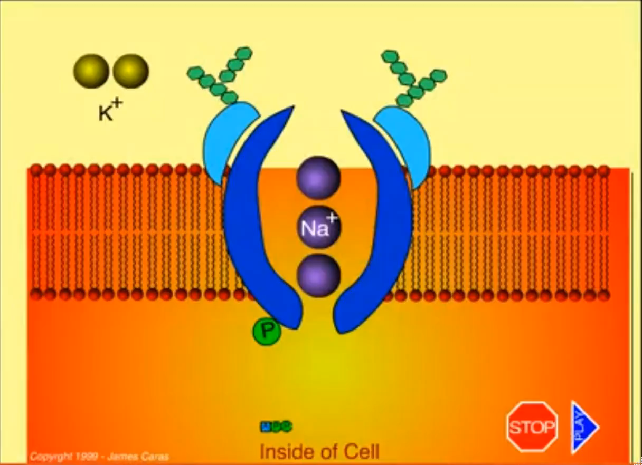
Importance of Na-K pump
At, resting potential V_{M} = -70 mV
I = I_{Na} + I_{K} + I_{cl} + I_{leak} = 0
But,
I_{K} ≠ 0, I_{leak} ≠ 0
These individual ion flows would cause the individual ion gradients to change (dissipate)
Na-K pump prevents that by specifically moving 3 Na+ ions outside the cell for every 2 K+ ions moved inside the cell.
Notes:
This pump obviously requires energy to function. Energy currency of the body? → ATP (Adenosine Triphosphate). So for moving 3 sodium ions out and 2 potassium ions in, it uses one ATP molecule. Notice that the pump overall… moves one positive charge outside the cell → thus maintaining the inside of the cell negative wrt outside.

Slide 20












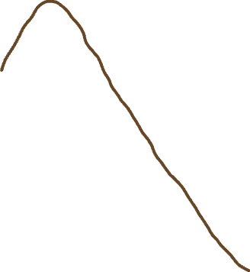

Neuron at resting is waiting to roll down its ionic gradients → Action potential
Main players in generating an action potential -
Passive Potassium (K) Channels
Fast Voltage-gated Sodium (Na) Channels
Slow Voltage-gated Potassium Channels
Notes:
Action potential generated with external excitation → makes the inside more positive → thus disrupts the balance between electric potential and the chemical potential.

Slide 21
























Channel open: Both gates open
Channel closed: At least one gate closed

Slide 22



Few terms
Both sodium and potassium channels OPEN with increase in voltage,
BUT
Potassium channels are slow
(Also, sodium channels get inactivated (CLOSE) as voltage becomes very high)
Both sodium and potassium channels CLOSE with increase in voltage,
BUT
Potassium channels are slow
Depolarization
$$Change in V=−$$
Towards resting
$$Change in V = +$$
Repolarization
Resting membrane potential
= - 70 mV
$$Change in V =−$$
Away from resting
Hyperpolarization
V: Membrane potential (V_{in} – V_{out})

Slide 23
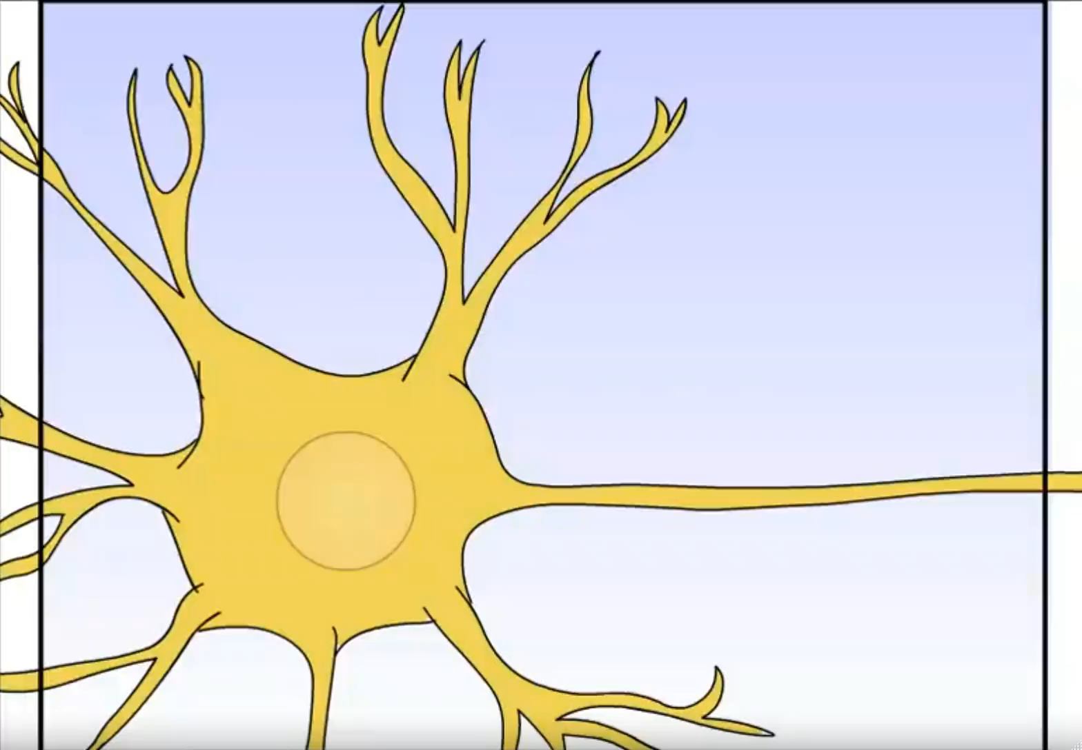
Action potential - animation

Slide 24
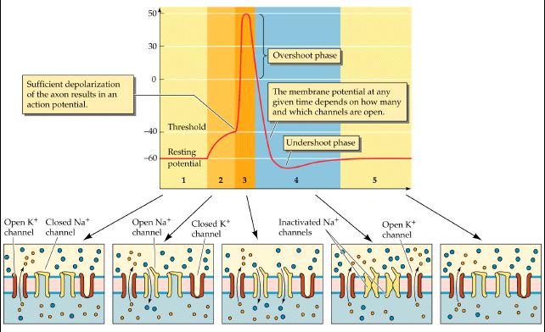
Action Potential
Notes:
Refractory period → this is the period where the sodium channels are in an inactivated state → so an action potential cannot take place.
(Sodium channel’s activation – deactivation kinetics is fast; Sodium channel’s inactivation – de-inactivation kinetics is relatively slower.)

Slide 25
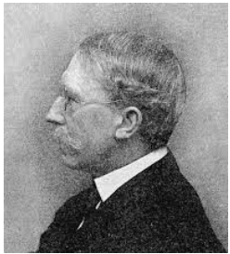
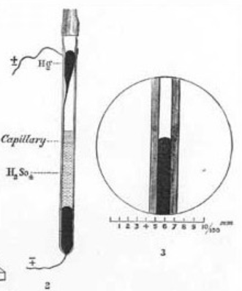
All or none principle
Capillary electrometer: Current from nerve impulses was passed through the mercury inside the capillary – this caused mercury to rise – Always rose the same height; Also, a second height deflection could not be produced right after the first one. Discovery of all or none principle and refractory period
Francis Gotch (1853 – 1913)
For any input that is able to induce an action potential in a neuron, the amplitude and the duration of an action potential always remains the same irrespective of the intensity of the input.

Slide 26
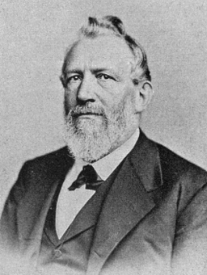
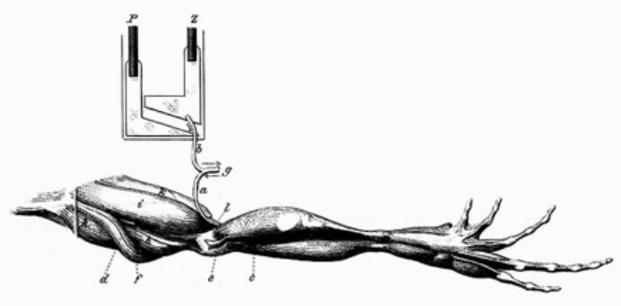
Why is it called ‘action’ potential?
First observation of action potential (1843): Sciatic nerve of a frog - Wave of relative negativity observed to be necessary for muscle contraction (‘Action electricity’)
Emil Du Bois Reymond (1818 – 1896)
Notes:
Electrically stimulated the exposed sciatic nerve. As he stimulated the nerve, he also observed that the electrode on the nerve showed a decrease in potential that travelled down the nerve to the muscle, and he called it a wave of relative negativity and he found that it was necessary for the ‘action’ – for the muscle to contract.

Slide 27
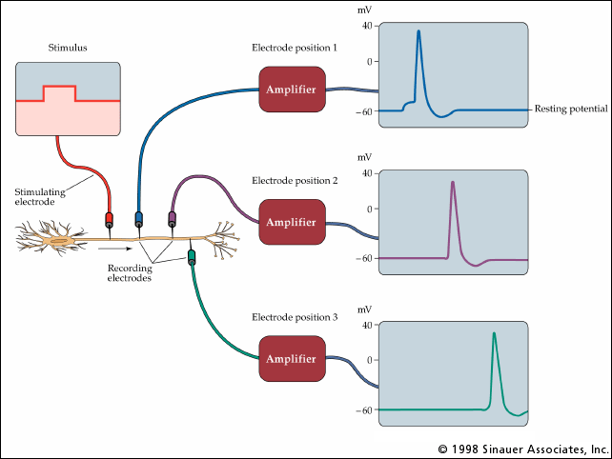
Action Potential Propagation – unmyelinated axon (~ 10 m/sec)
Notes:
Once generated, action potentials travel down the axon.

Slide 28
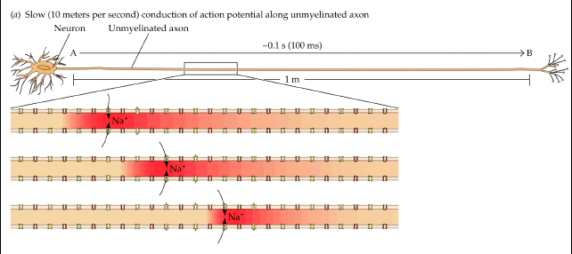
Notes:
*In an unmyelinated axon, conduction is slow
*The wave of positive charge tends to dissipate and would disappear before reaching the end of the axon, except for Na channels along axon
*Na channels “refresh” the action potential as it travels along axon
*The action potential only travels in one direction, because the Na channels in the wake behind it are refractory

Slide 29
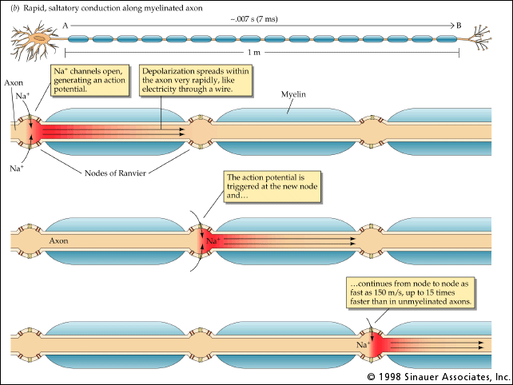
Action Potential Propagation – Myelinated axon (~ 100 m/sec)
Nodes of Ranvier
Saltatory conduction
Notes:
*When an axon is myelinated, it prevents K from leaking out
*This keeps the action potential from dissipating and allows it to travel farther down axon, up to 15 times faster
*Action potential regenerated at Nodes of Ranvier, which are gaps between myelin segments (that is why there are gaps)

Slide 30
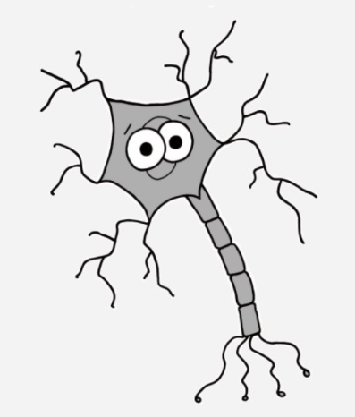
I have some questions!
1. Where is the decision to fire or not made in the neuron?
Dendrites B. Axon terminals
Nodes of Ranvier D. Axon hillock
2. Which among the following pulls down the resting membrane potential?
A. Na⁺ B. K⁺
6. If myelination improves speed, why can’t the whole axon be myelinated?
4. Which ion among the following is responsible for repolarization of the action potential?
A. Na⁺ B. K⁺
3. Which among the following constitutes the current during the upshoot of the action potential?
A. Na⁺ B. K⁺
7. Why doesn’t the action potential propagate in both directions?
5. The period immediately after an action potential during which the neuron cannot fire another action potential is called?
Repolarization period B. Revenge of K+ C. Refractory period
Notes:
Answers:
D – Axon hillock
B – Potassium
A – Sodium
B – Potassium
C – Refractory period
Signal will die out until it reaches axon terminals
Refractory period

